Slide 1
Chapter 18 Model Basics with modelr
Understand the essence of modeling

Slide 2

First- define a family of models
Second-generate a fitted model
What is the difference between + and *

Slide 3
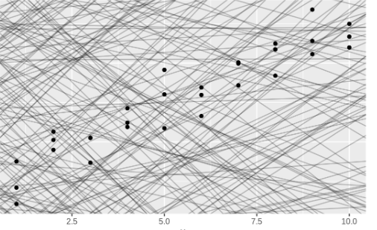
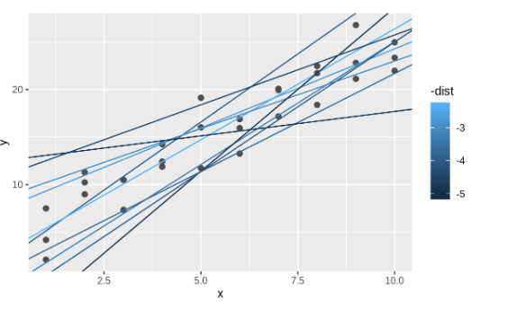
Geom_abline
Best 10 models

Slide 4
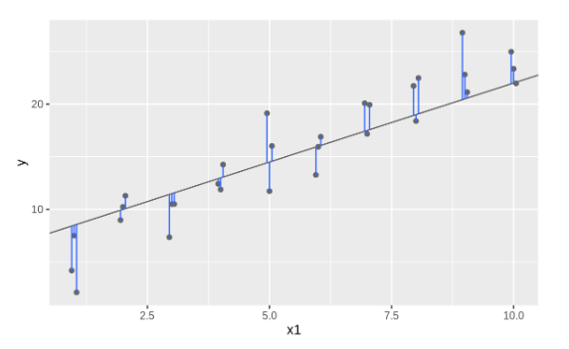
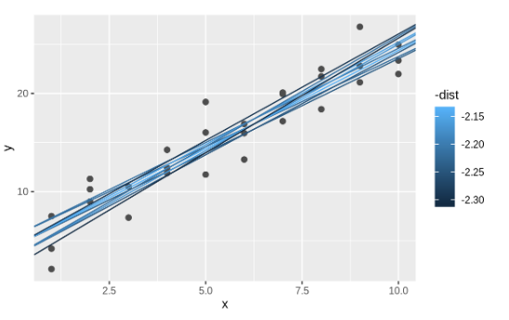
Overlay best 10 models
Residuals

Slide 5
Useful functions
Add_predictions()
Add_residuals()
Average residuals will always be ZERO
Gather_predictions()
Spread_predictions()
Pretty=TRUE
Na.action=na.warn
Makes sure you get a warning for dropping missing values

Slide 6
Other Models
stats::glm()
Generalised linear models extend linear models to include non-continuous responses (e.g. binary data or counts).
mgcv::gam()
glmnet::glmnet()
MASS::rlm()
Good for outliers
rpart::rpart()
randomForest::randomForest()
xgboost::xgboost

Slide 7
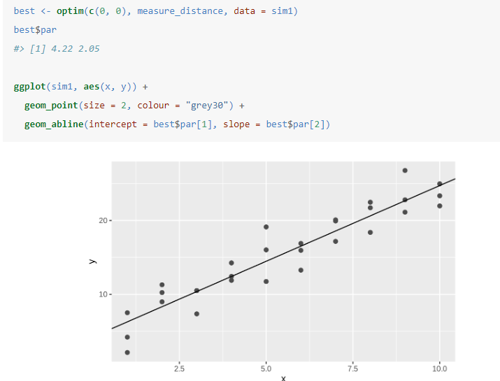
Newton-Raphson

Slide 8
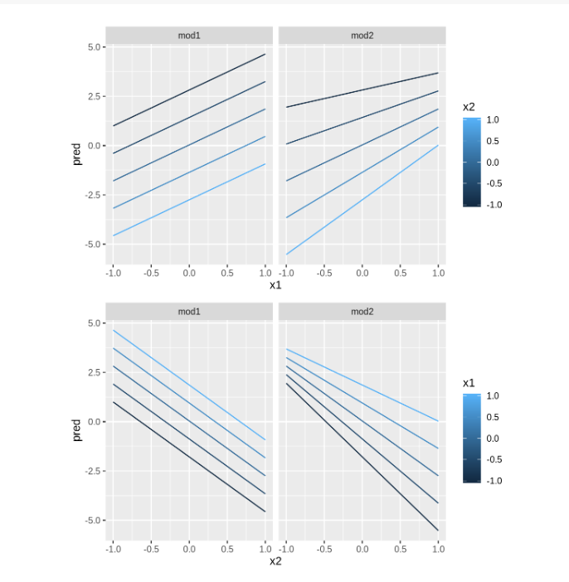

Slide 9
Chapter 19 Model Building

Slide 10
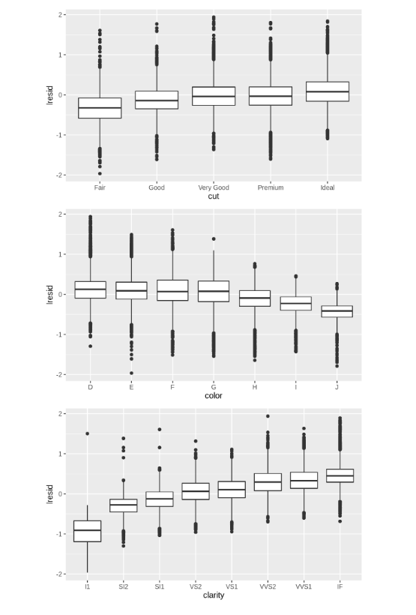
Residual Plots
How to interpret the y axis ?

Slide 11
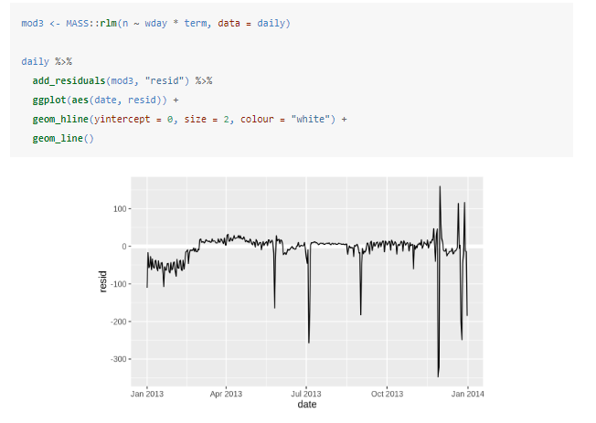
Use rlm() to remove outliers

Slide 12
Chapter 20 – Many Models with purrr and broom
Notes:
Basic workflow then details

Slide 13
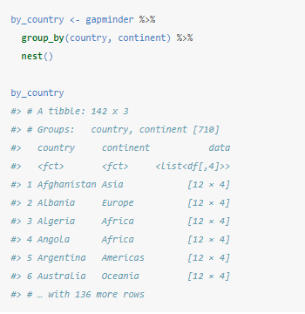
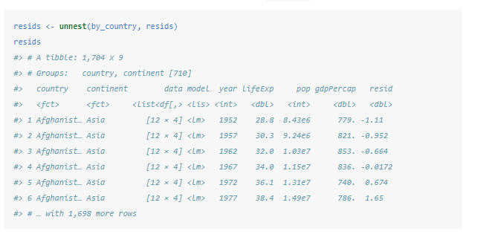
Nesting vs. Unnesting
Grouping data frame
Data frame with a column that is a list of other data frames
Back to regular data frame and can plot the residuals

Slide 14
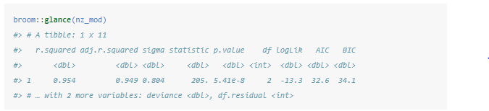
Model quality –other than residuals
broom::glance(model)

Slide 15
List-columns
Vectorised functions
Purrr::map()
Apply model to each element in the list
Tidyr::Nest()
Convert grouped data to list
Mutate()
summarise()
Stringr::str_split()
Vector to list
Unnest()

Slide 16
Simplifying list-columns
For single value, use mutate() with map_lgl, map_int,map_dbl,map_chr
For many values, use unnest()

Slide 17
Exercises
Pg356- 2
Pg 395-3
Pg415-2,4

